Slide 1
Data Analysis & Modeling
- Ashish Chandra Jha

Slide 2
Business Understanding
A computational system records transactions. These transactions are stored in a time series log. Now consider following scenarios,
Scenario 1: In a grocery store, a sales purchase is made for some goods. This transaction with relevant information is recorded in a log by a computer system. This log then contains historical information of all the goods purchased in that store.
Scenario 2: A Cloud platform continuously records the resource utilization of instances per minute and stores this information in the resource utilization log. For example, Instance A, has its CPU, Memory, Disk and Network Bandwidth utilization with a timestamp stored in a log file. This log file then contains the historical data of resource utilization from the time that Instance A was created and till the time it was destroyed.
Scenario 1 and Scenario 2 are completely different, and are only related by the fact that forecasting is a useful tool to conduct strategic and optimization planning. Assume relevant variables to understand the problem statement, for example, in scenario 1, overall sales forecasting would require transactional logs of all the sales, and cosmetic sales forecasting would require logs related to cosmetics. Where as in case of scenario 2, predicting future resource utilization for a single instance would require the resource utilization of that single (here) instance A, where as to predict resource utilization of a project/group, resource utilization logs of all the instances in that group (say) instance A, B, C, D, E, F will be required.

Slide 3
1. Link to the code base as a GitHub / GitLab Repo
https://github.com/AshishCJha/Implementation-of-regression-techniques-on-time-series-data-to-generate-future-predictions

Slide 4
2. a) Problem Statement
Given scenario 1 and 2, How can we use Machine Learning constructs, to implement an intelligent system, that allow the user to see a predicted forecast of transaction. Input to the system is transactional log files. The system is expected to perform required data cleaning and transformation. Then the system is expected to perform required analysis on the processed data and generate results in terms of future predictions. The output of the system should be a predicted transactional log.

Slide 5
2. b) Brief description (your understanding about the problem and its brief explanation)
Given Description:
This hypothetical data-set represents transactional logs of resource utilization of over 3000 instances. This data-set includes over 3000 folders, wherein each folder has a unique name, e.g. `group_4_506294bf-c2d1-4c3e-887f-ab10f04908d7` where `group_4` represent the group ID and instance `506294bf-c2d1-4c3e-887f-ab10f04908d7` belongs to that group ID. This folder has a file named as `mem.log` which contains resource utilization records. Each record is of the format, "{timestamp}:{Memory Allocated}:{Memory Used}:{CPU Allocated}:{CPU Used}:{Network bandwidth utilization}:{Storage space utilization}"

Slide 6
2. c) Proposed Solution
Data Extraction from Log files
Data Pre-processing
Checking for missing value (can be treated with Data Imputation)
Changing the time format in '%Y-%m-%d'
Exploratory Data Analysis
Modeling (Time Series Analysis)
Modeling (LSTM)

Slide 7
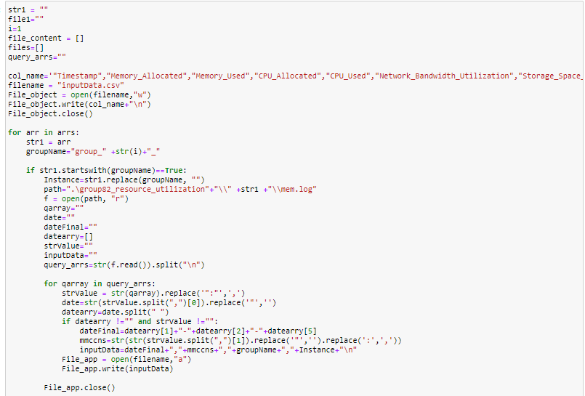
Data Extraction from Log files

Slide 8
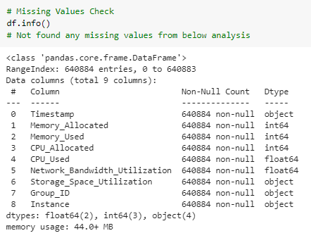
Data Pre-processing
Not found any missing values from below analysis

Slide 9
Data Pre-processing
Formatting the time

Slide 10
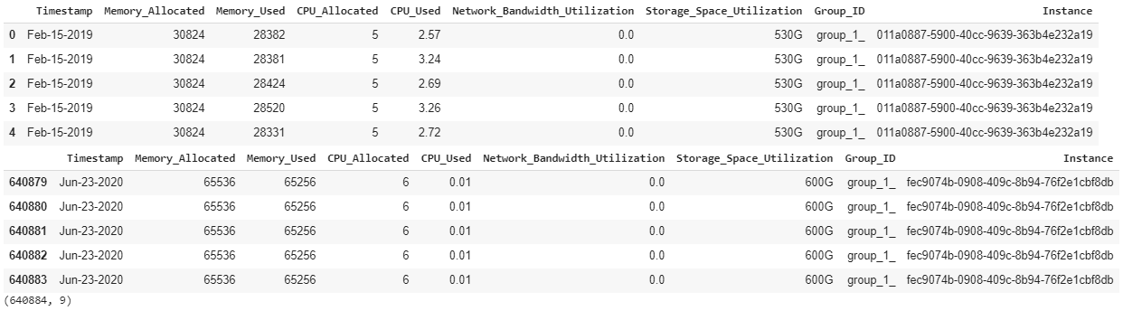
Exploratory Data Analysis

Slide 11
Modeling
Time Series Analysis
LSTM (Deep Learning)
Regression Analysis

Slide 12
2. d) Block Diagram
Data Extraction
Data Preparation
Exploratory Data Analysis
Data Modelling
Model Evaluation and Tuning
Check top, bottom data, describe, and info
Log Data
Select Data
Time Series
Hyper tuning the model parameter
Recommend for future growth and cost optimization
Feature Selection
Clean Data
LSTM
Error Minimization
Checking for missing value (can be treated with Data Imputation)
Regression
Changing the time format in '%Y-%m-%d'

Slide 13
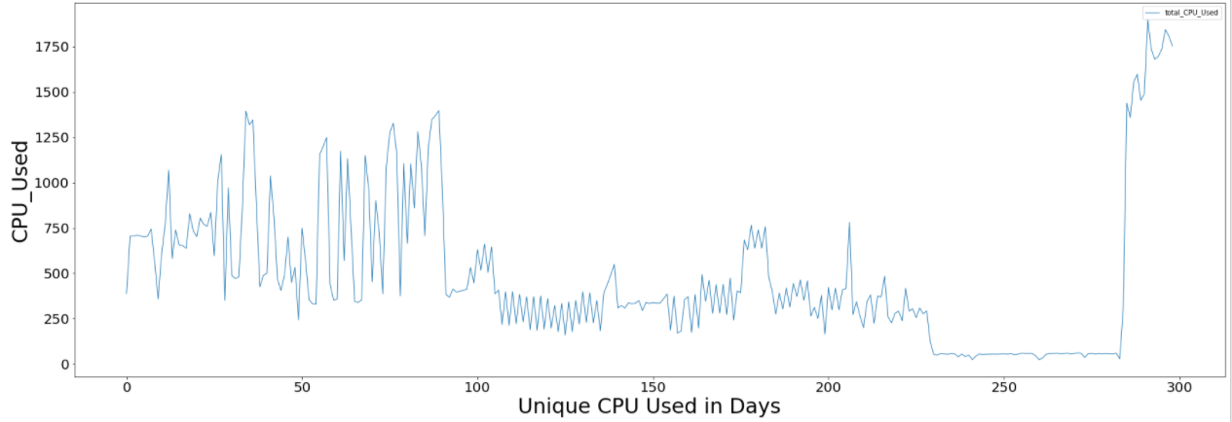
2. e) Sample Test Results

Slide 14
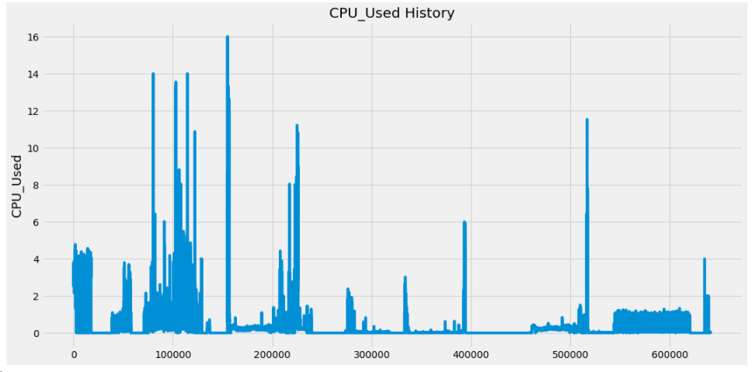
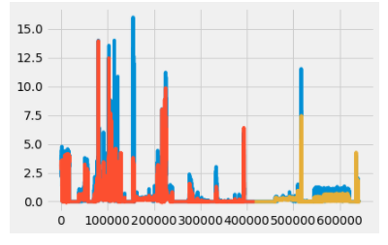
2. e) Sample Test Results

Slide 15
2. f) Future Scope
Resource Optimization to cut down the cost
Forecasting the sales to increase the revenue

Slide 16
3. Document containing references, bibliography items
Time Series Prediction for one of the project for Retail Client
My research paper “ Aspect Based sentiment analysis on Bangalore restaurant” at IIM Bangalore

Slide 17
Thank You

